Slide 1
Validation Framework
Module - 18

Slide 2
Contents
Data Validation Framework
Validation Service
Administration cockpit
Cockpit Integration

Slide 3
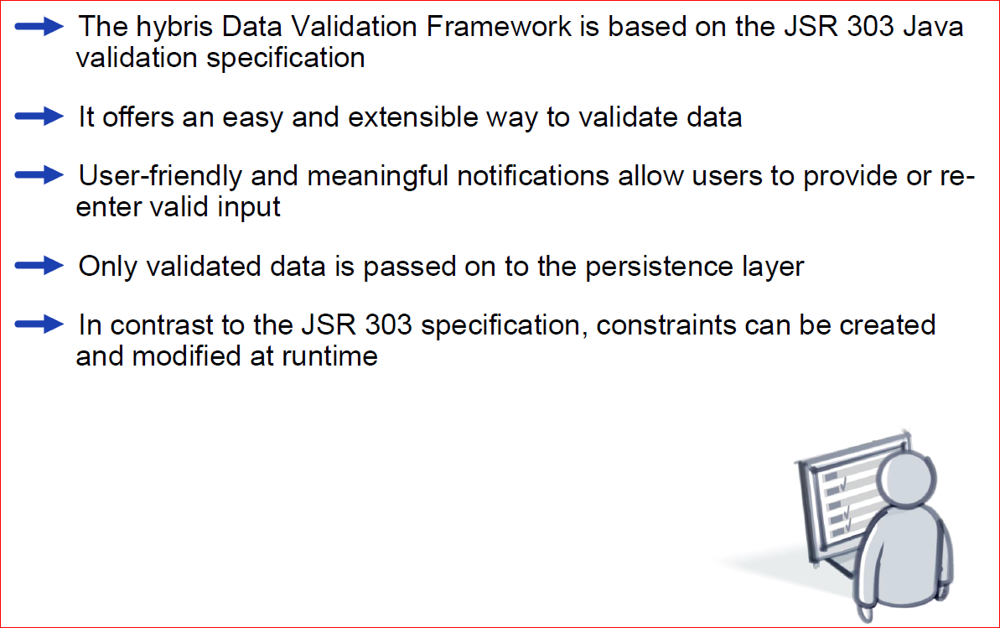
Overview

Slide 4
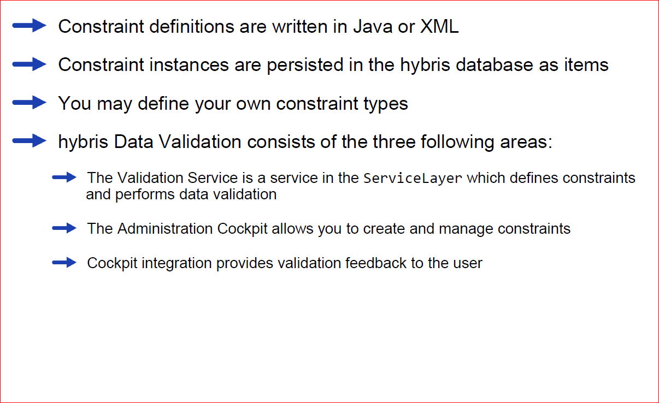
Overview(continued)

Slide 5
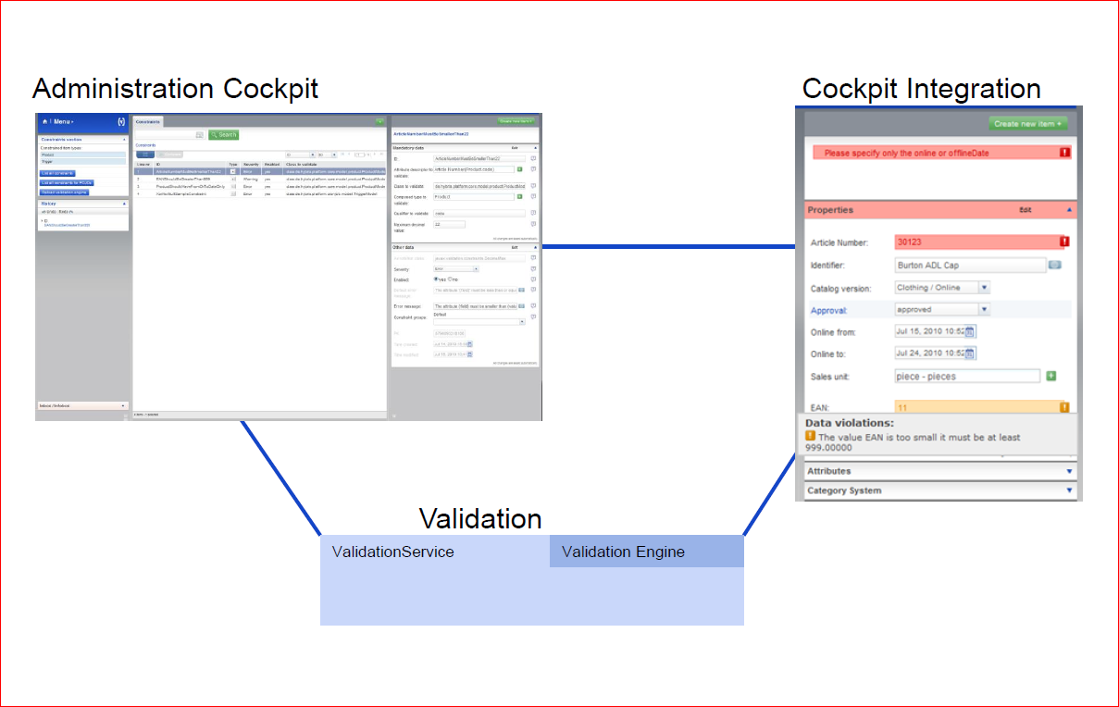
Definition and use

Slide 6
Contents
Data Validation Framework
Validation Service
Administration cockpit
Cockpit Integration

Slide 7
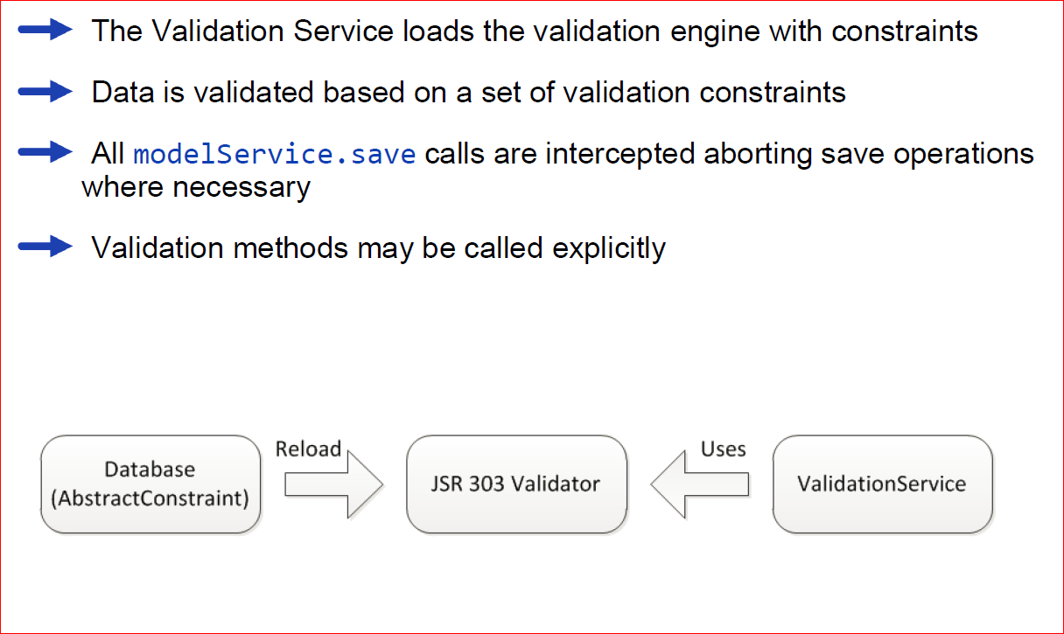
Key Features

Slide 8
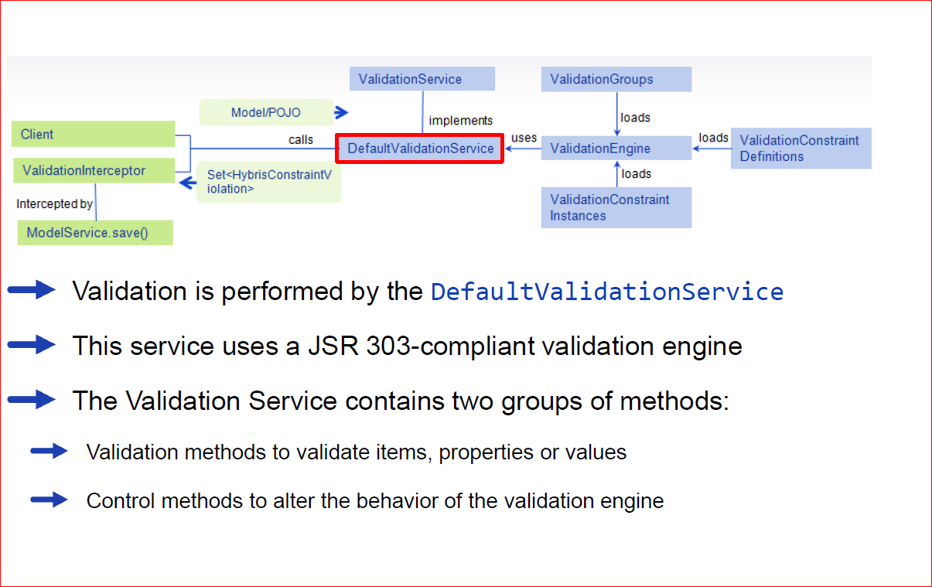
Architecture

Slide 9
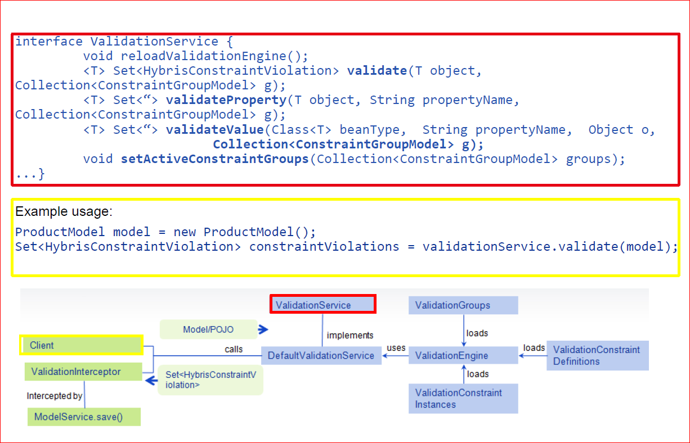
Example

Slide 10
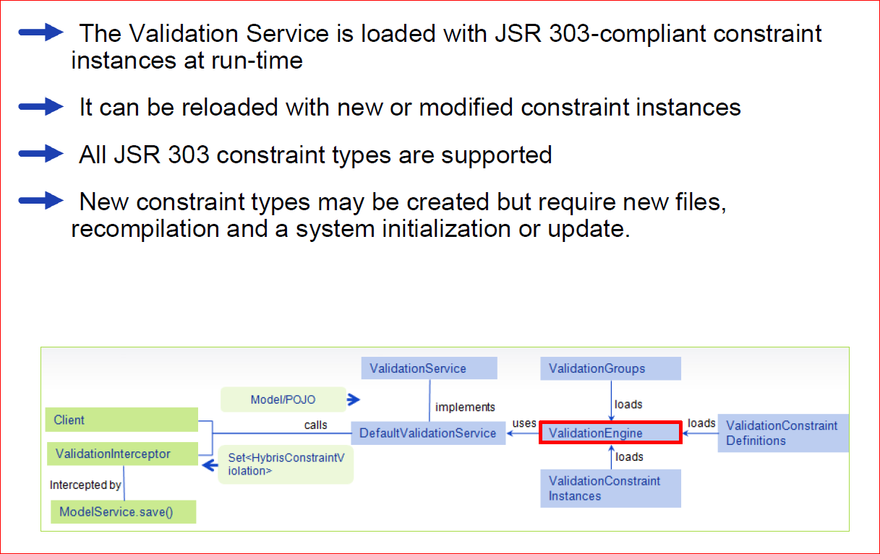
Validation Engine

Slide 11
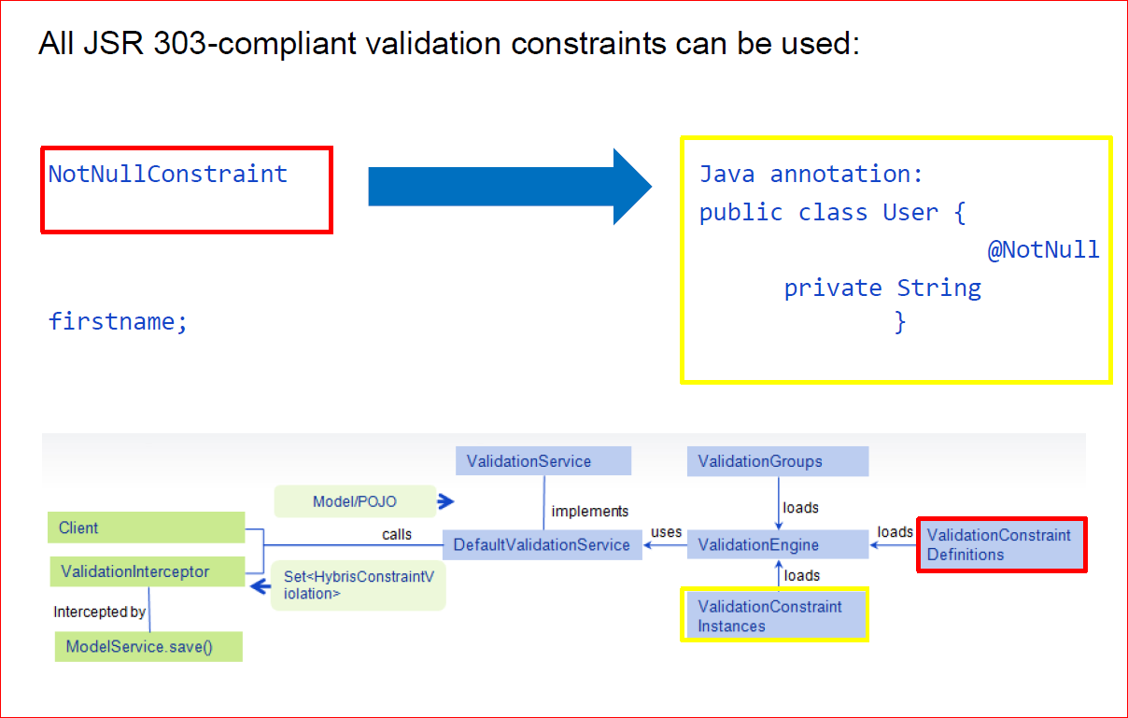
Constraints

Slide 12
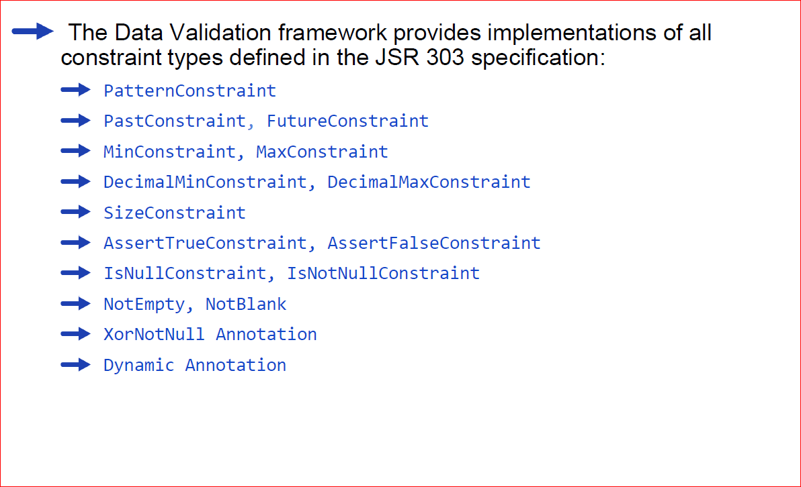
OOTB Constraints

Slide 13
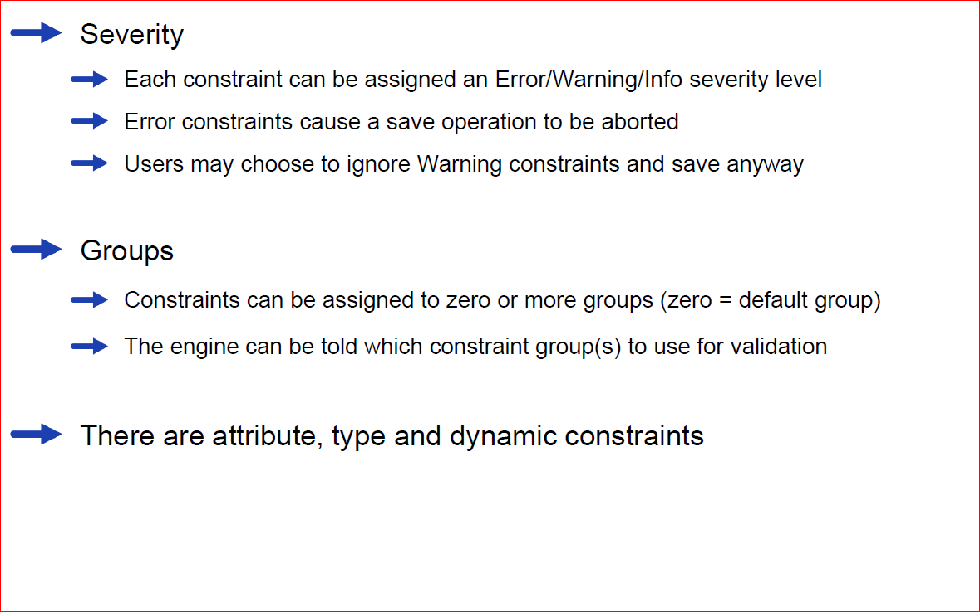
Constraint types

Slide 14
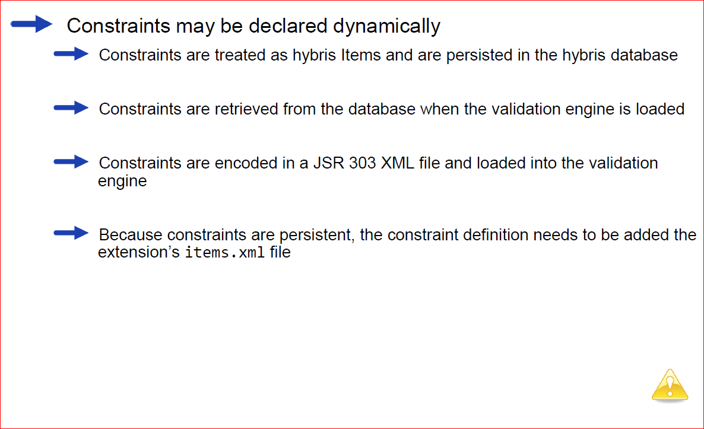
Declaring Constraints Dynamically

Slide 15
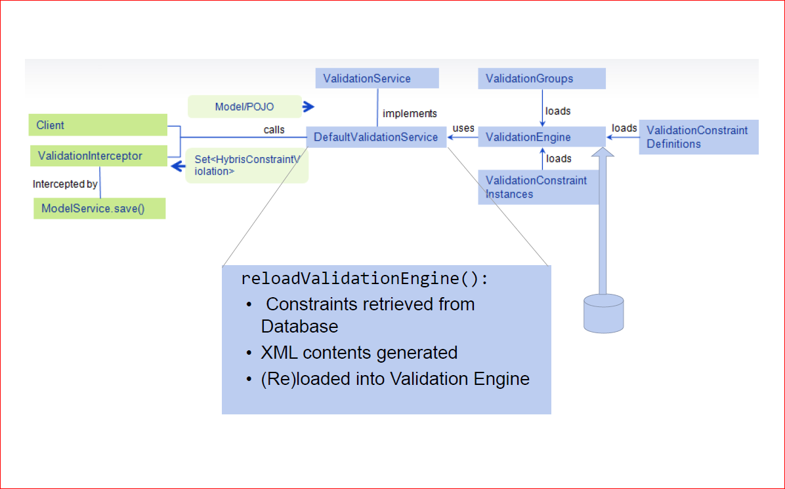
Declaring Constraints Dynamically (continued)

Slide 16
Contents
Data Validation Framework
Validation Service
Administration cockpit
Cockpit Integration

Slide 17
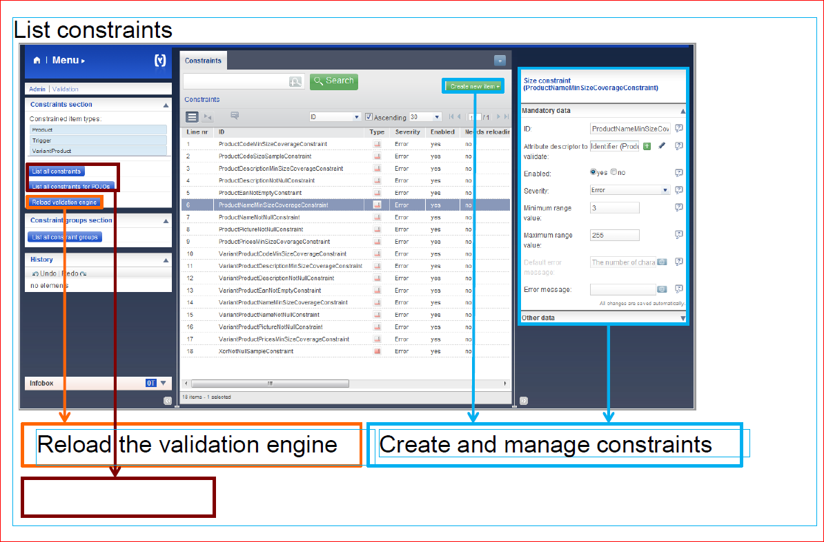
Administration Cockpit overview

Slide 18
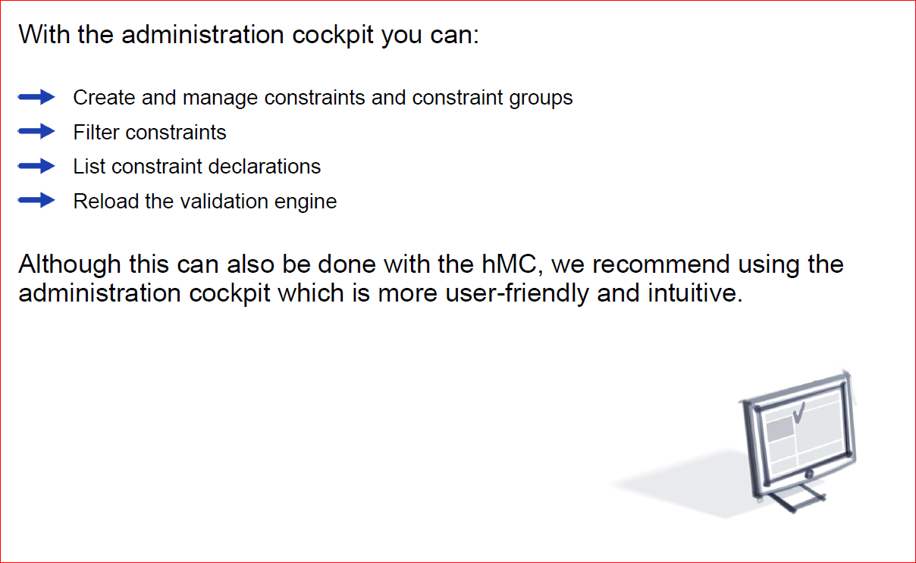
Features

Slide 19
Contents
Data Validation Framework
Validation Service
Administration cockpit
Cockpit Integration

Slide 20
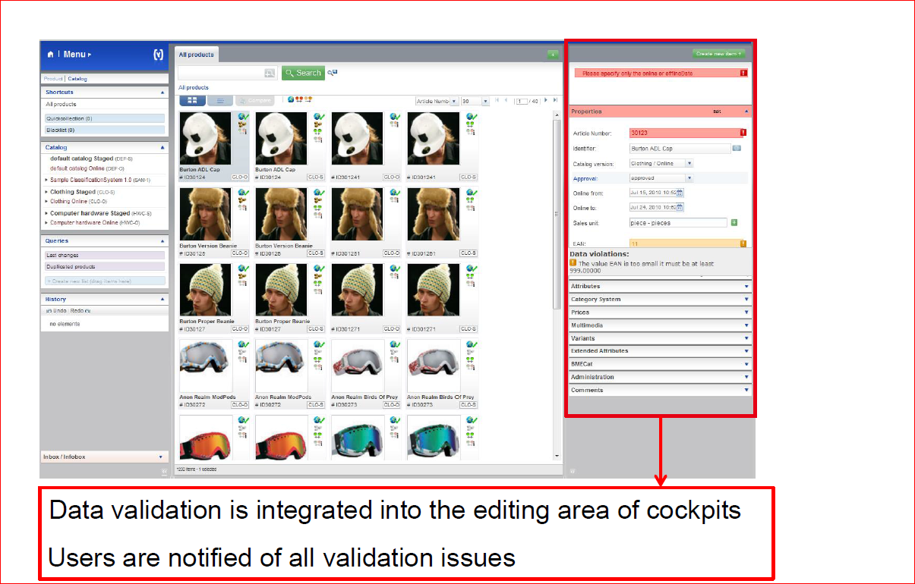
Cockpit Integration

Slide 21
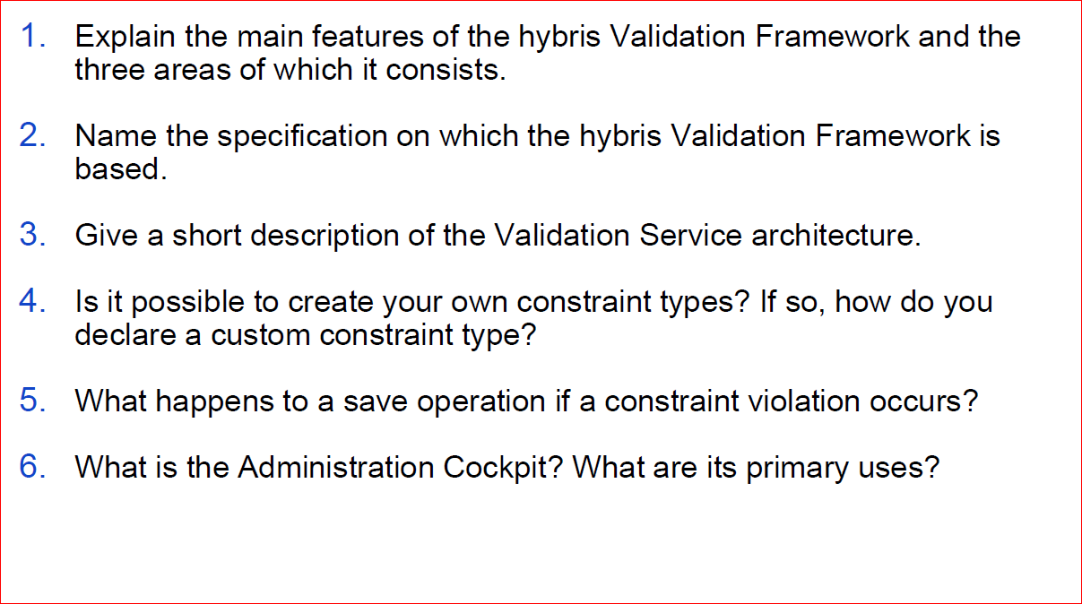
Quizzies

Slide 22
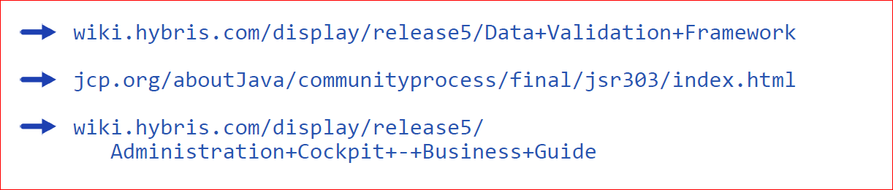
References

